Slide 1

Data Stream
Done By
Riham Mansri
Mohamed issa
Mootez Dakhlaoui

Slide 2
Outline
On-line regression trees with options
The xStream outlier detector
Randomized Subspace Hashing

Slide 3
On-line regression trees with options

Slide 4
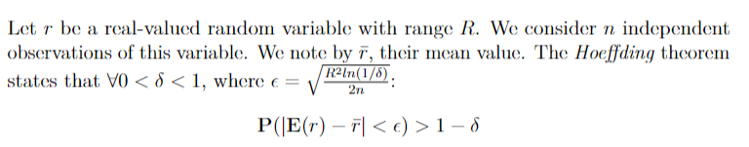
Hoeffding Trees
Hoeffding regression tree is an online regression tree model that uses Hoeffding bound as a “confidence criterion” for choosing the best split attribute.
Hoeffding bound
The random variable “r” represents the heuristic measure used to choose split attributes.

Slide 5
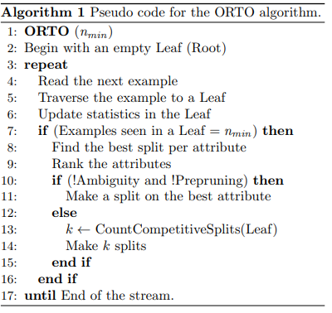
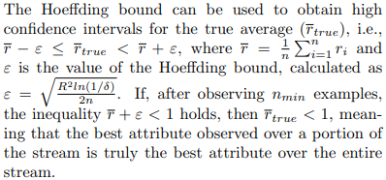
ORTO: On-line regression Tree with Options
The confidence criterion for selecting the best attribute is the ratio of the variance:
r=VR(A2)/VR(A1), where Ai is the i-th best attribute for variance reduction.

Slide 6
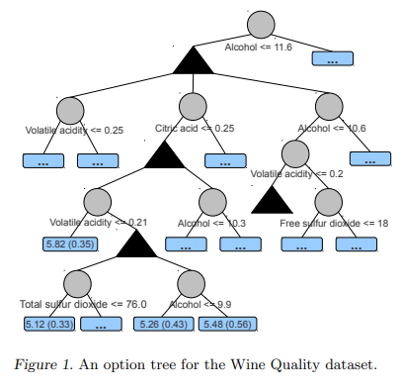
ORTO Structure

Slide 7
II. The xStream outlier detector

Slide 8
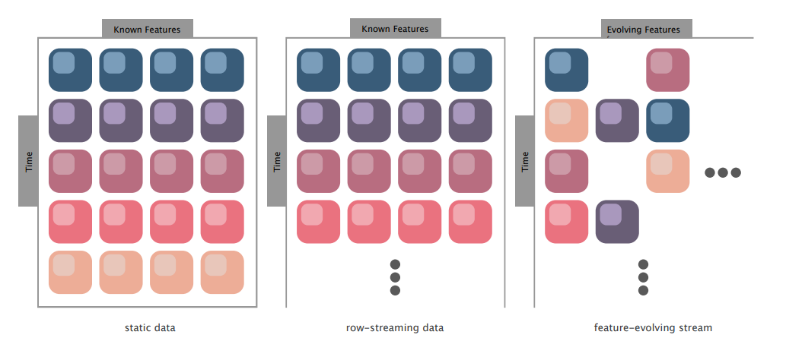
xStream

Slide 9
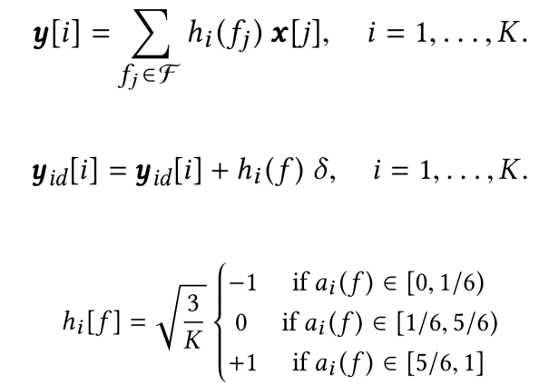
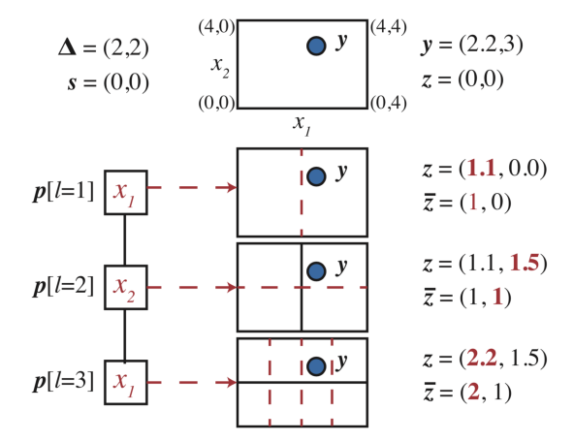
Proposed Method: xStream
• The method is built on the following components:
1. StreamHash: subspace-selection and dimensionality reduction via sparse random projections
2. Half-Space Chains: an efficient ensemble to estimate density at multiple scales.
Stream Hash
Half-Space-Chains

Slide 10
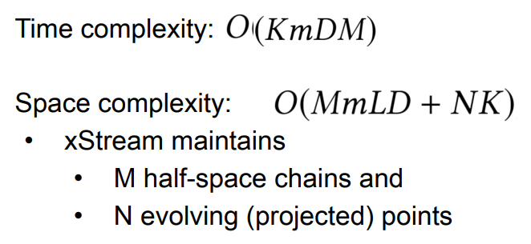
Complexity of the model
K: Low dimension Space
m: number of hashtables
M: Total of number of chains
D: depth of each chain
L: Size hashtable
N: Evolving number of points

Slide 11
III. Randomized Subspace Hashing : RS-Hash

Slide 12
Presentation of the algorithm
An unsupervised learning method.
An algorithm for outlier detection that helps solve the problems faced by conventional outlier detection methods (such as distance-based methods) .
It relies on randomized hashing which results in a linear complexity with size of the dataset.
It offers a better complexity, is faster and more robust than a lot of outlier detectors and is very accurate.

Slide 13
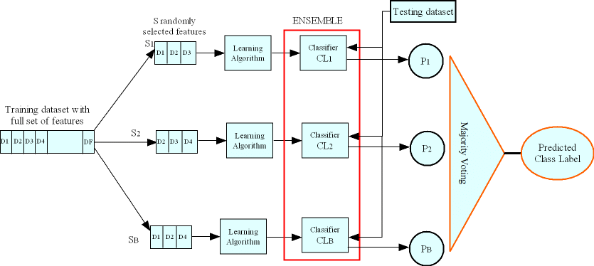
How the algorithm works
Part 1 :
The approach is ensemble-centric. It uses several independent executions of a base outlier detector over subsets of the data (Bagging).
The final score of a data point is averaged from the different scores of the different executions.

Slide 14
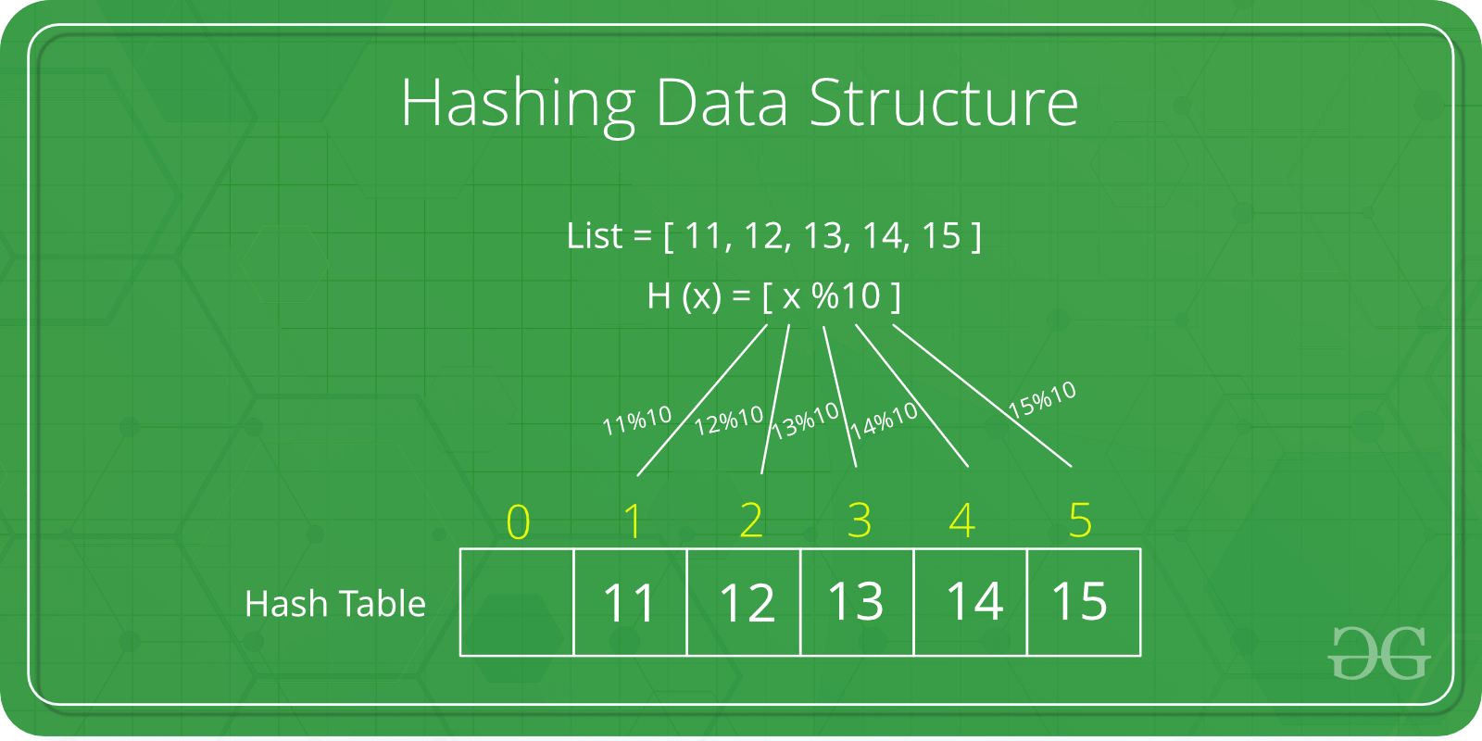
Part 2 :
The algorithm uses hash tables and hash maps to transform the data points. Hash tables are defined by keys and values and the hash maps let us use flexible keys instead of the regular indices of an array.
This is what reduces the complexity.

Slide 15
Parameters and complexity of the method
Parameters :
n : number of the data points.
d : dimensions of the dataset.
s : size of a data sample (constant).
m : number of components/executions.
r : a random integer used to select dimensions from the dataset and construct a set V of dimensions.
w : number of pairwise independent hash tables.
Complexity :
Training phase : for each component, we have a complexity of O(s) with s constant.
Testing phase : overall complexity of O(n).

Slide 16
Conclusion

Slide 17
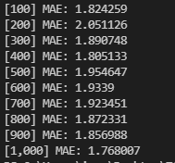
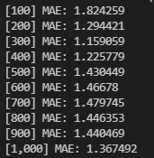
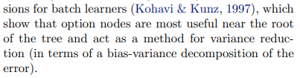
Test of ORTO model / Hoeffding Tree
Results of the Hoeffding tree algorithm
Results of ORTO algorithm
We see that the ORTO model outperforms the Hoeffding tree regression model.
Added to this the results confirm what is mentioned in the article: Options are more significant close to the root. (The reduction is very high in the first MAE values)

Slide 18
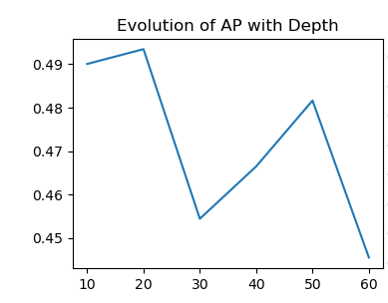
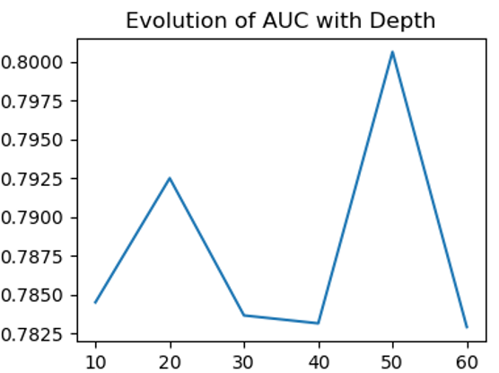
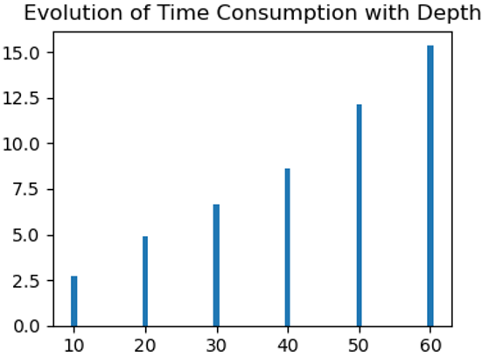
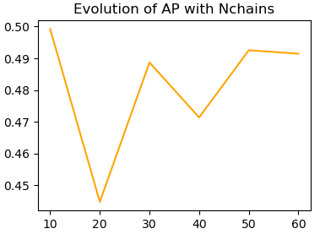
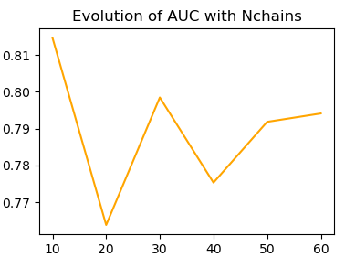
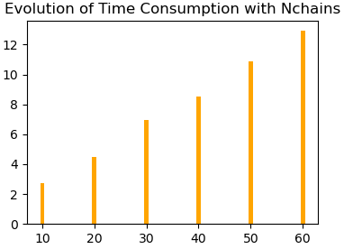
Xtreme : Performance of the model when changing parameters

Slide 19
Thank you for your attention

